Slide 1
ERP v. Regressed ERP (rERP)
- Matthew Burns, Nima Bigdely-Shamlo, Nathaniel Smith

Slide 2
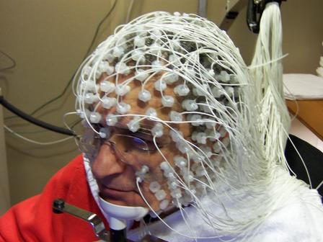
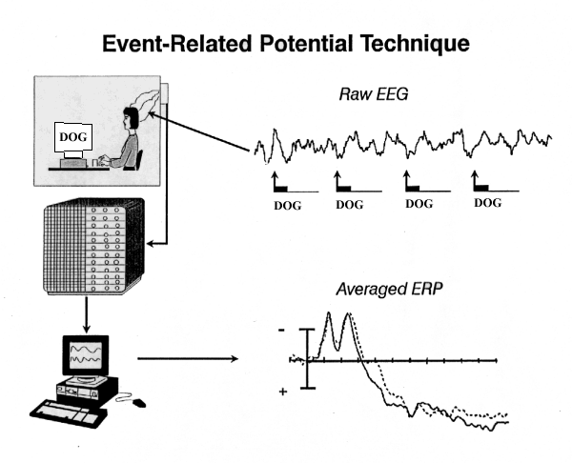
Background
Electroencephalography - EEG
ERP

Slide 3
Averaged Event Related Potential
Notes:
Vertical cascade

Slide 4
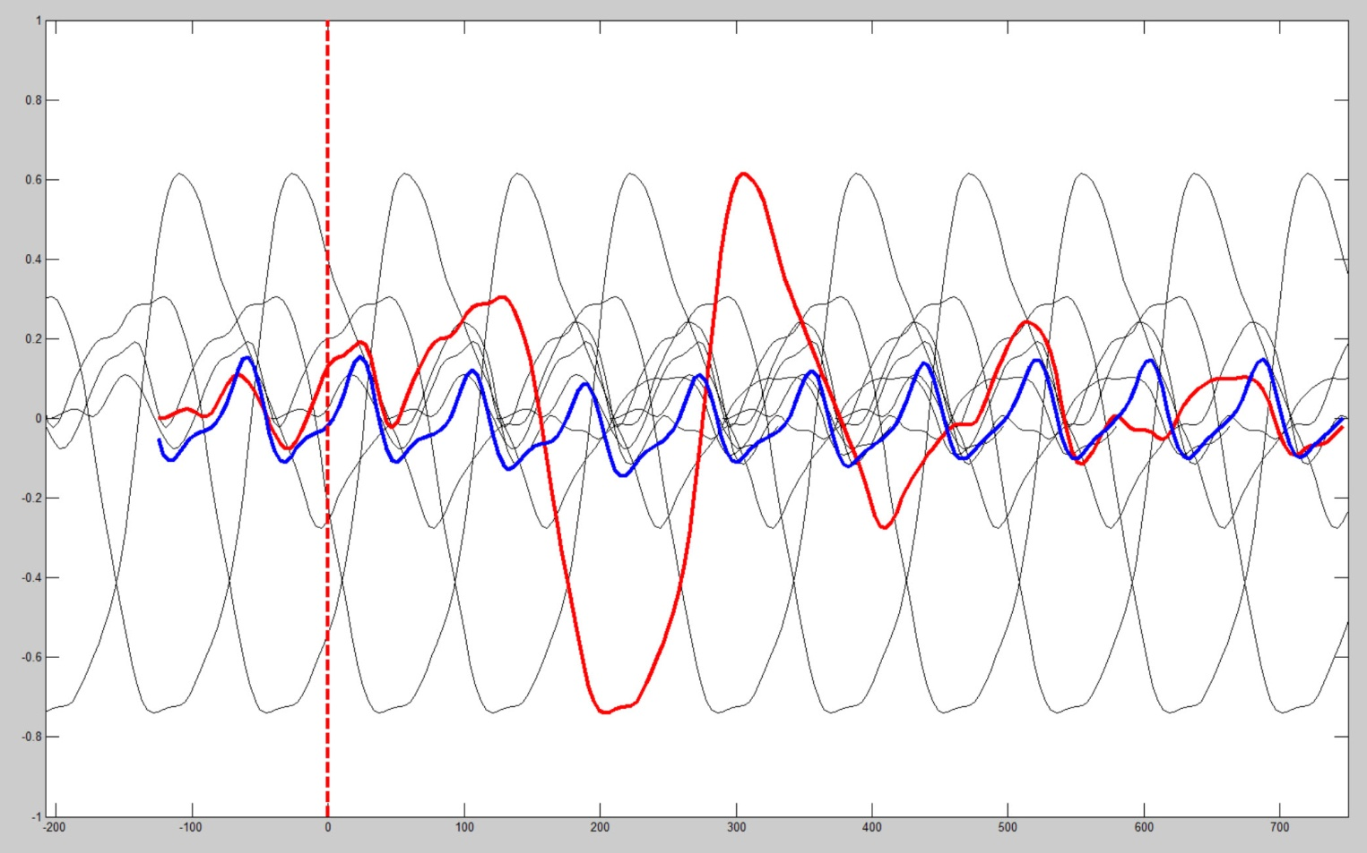
A Problem With Averaging
Notes:
Add dog tags

Slide 5
Looking for Templates

Slide 6
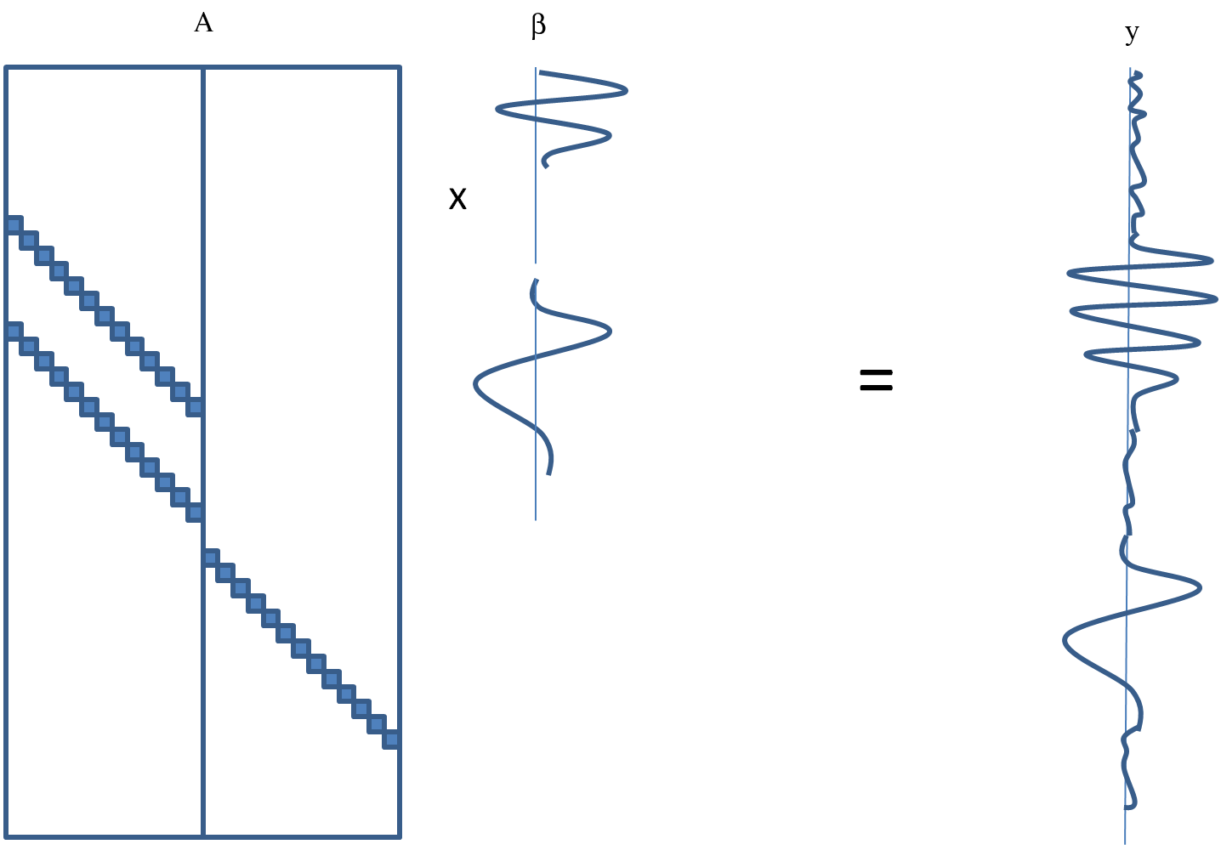
Regression Model
β’= (Α^{Τ}Α)⁻¹ Α^{Τ}y

Slide 7
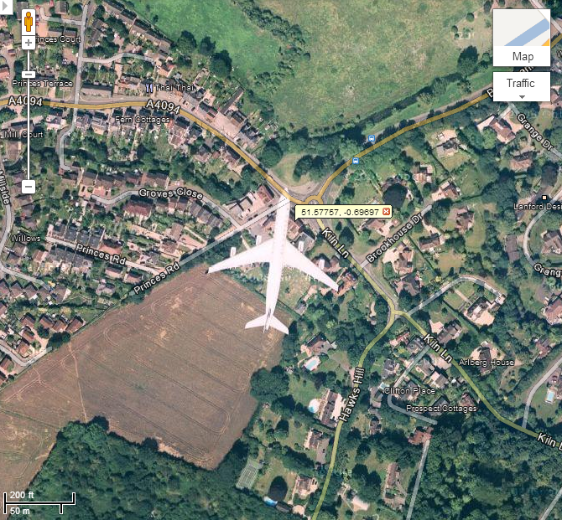
Rapid Serial Visual Presentation

Slide 8
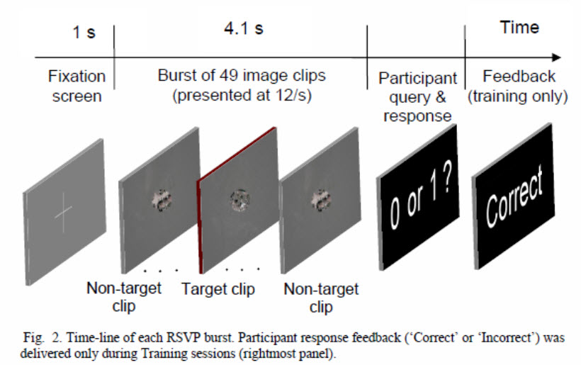
Experiment - RSVP

Slide 9
Event Type | Description
1 | Non-target frame
2 | Target frame (contains airplane)
4 | “No targets” response
5 | “One target” response
6 | Block start
16 | Start of trial
32 | “Correct” feedback given to participant
64 | “Incorrect” feedback given to participant
129 | Burst start

Slide 10
Analysis
Compute ERP and rERP for all 127 channels.
At each event, subtract the ERP and combined rERP estimates from original signal (noise).
Subtract variance of noise from variance of original signal (Reduction of Variance: AKA R-squared: AKA Coefficient of Determination).

Slide 11
Events
Predictor
Timeseries
pickle, base64 encoding
compile data into sequence file
~1.7 GB each file, 15-150 files
Sequence File
Map
Map
Map
Map
perform channel regression and
averaging.
Reduce
collect results
pickle, base64 encoding

Slide 12
HDFS
stage 1
dataset1.set
dataset2.set
dataset3.set
Map
Map
Map
dataset1.seq
dataset2.seq
dataset3.seq
stage 2
dataset1.seq1
dataset1.seq2
dataset1.seq2
Map
Map
Map
Reduce

Slide 13

HDFS
stage 1
dataset1.set
dataset2.set
dataset3.set
Map (scatter)
iterate again, update
Reduce (gather)
iterating complete
dataset1.seq
stage 2
dataset1.seq1
dataset1.seq2
dataset1.seqn

Slide 14
Map
Remove Outliers: non-trivial
Create sparse predictor matrix
Separate single channel into cross validation sets
Solve linear least squares problem (as quadratic program with cvxopt software)
Solve averaging problem
Compute Reduction of Variance for regression and averaging
Repeat for each cross-validation fold

Slide 15
Analysis
Compare Reduction of Variance (ROV) for averaging and regression (t test p=.01).
Compare ROV for ICA and raw channels for both methods.
Across all event types (in this case, 9 types)

Slide 16
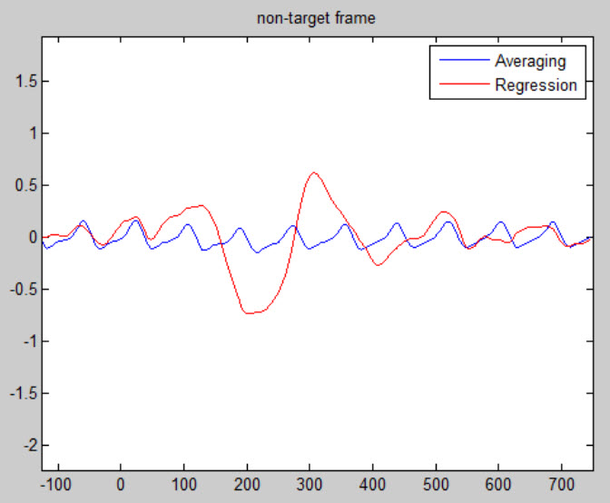
Comp 17, Event type 1 – ERP & rERP

Slide 17
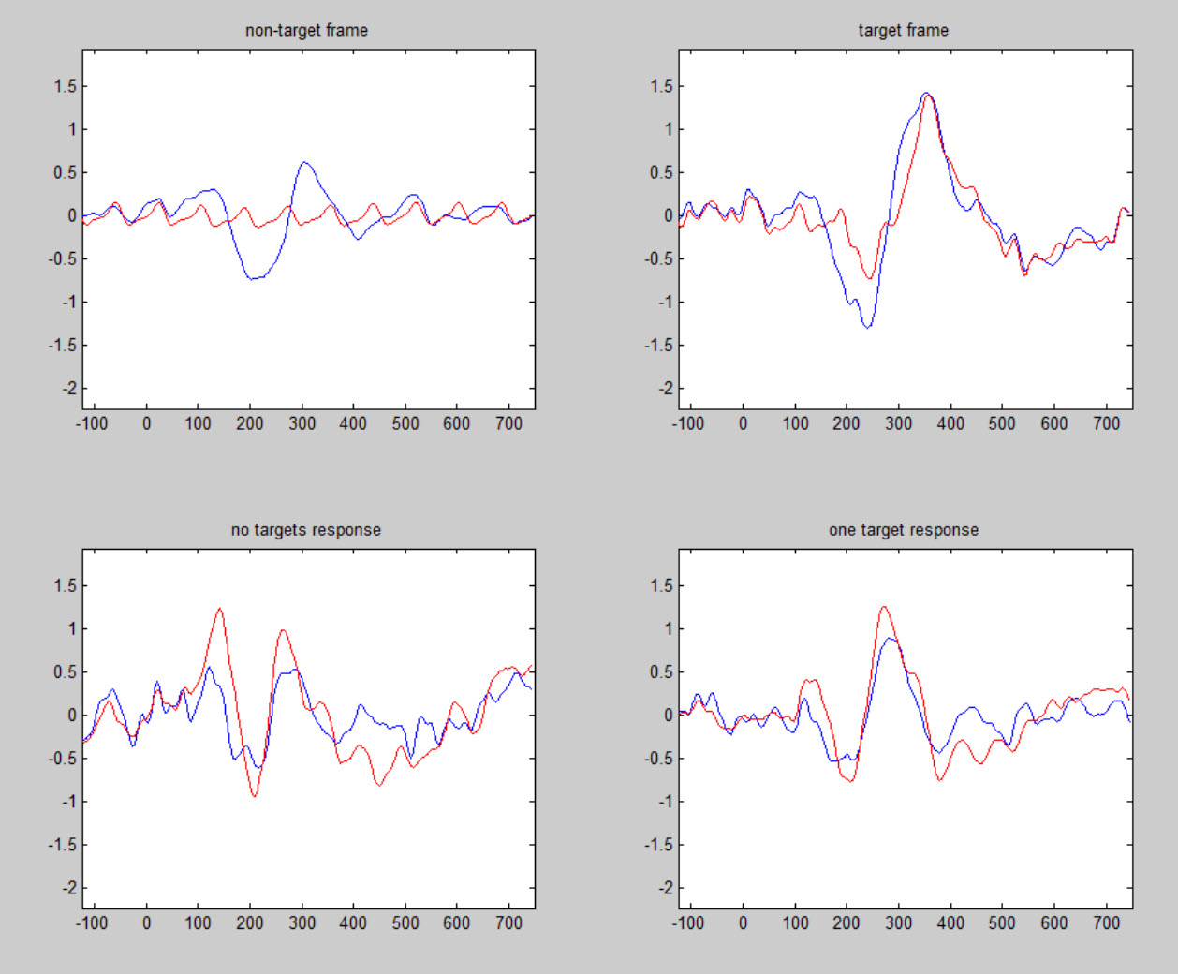
Comp 17 – ERP & rERP

Slide 18
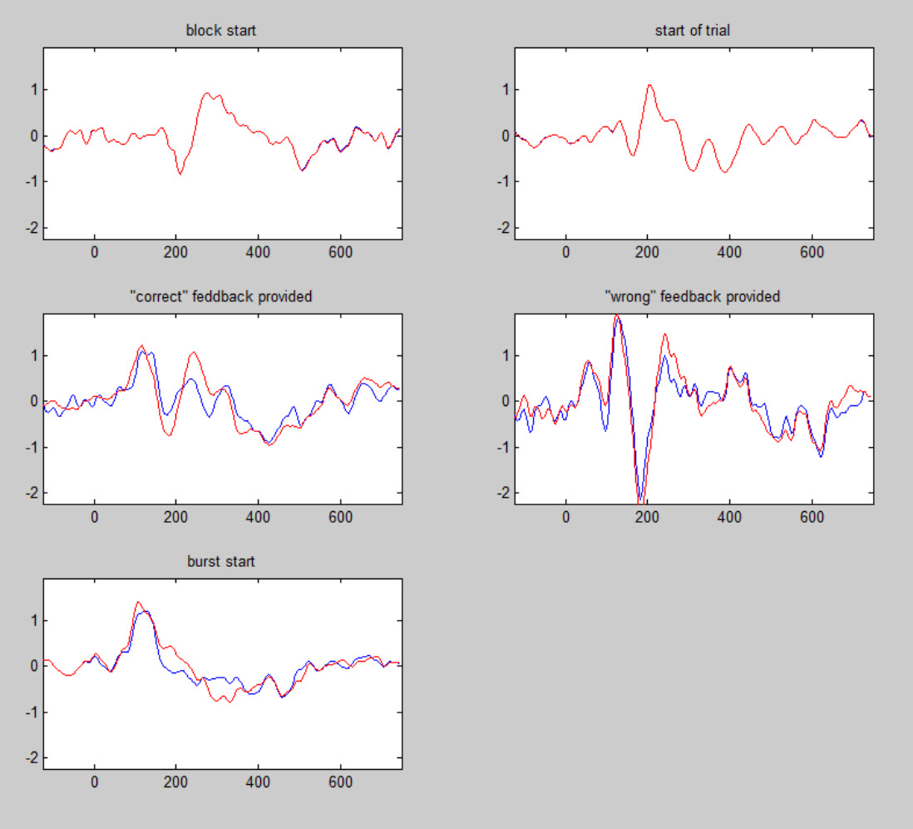
Comp 17 – ERP & rERP

Slide 19
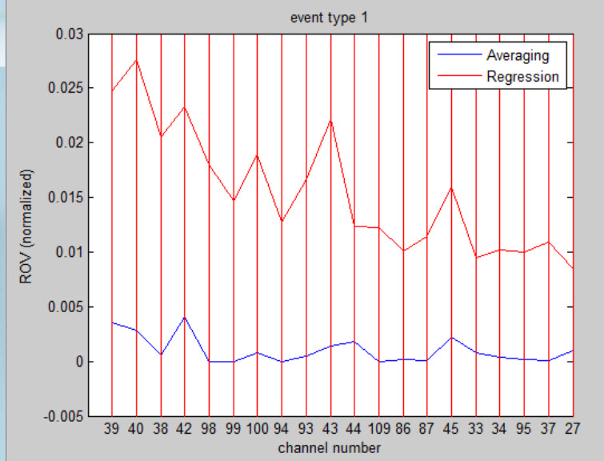
Channels, Event type 1 – ROV (normalized)

Slide 20
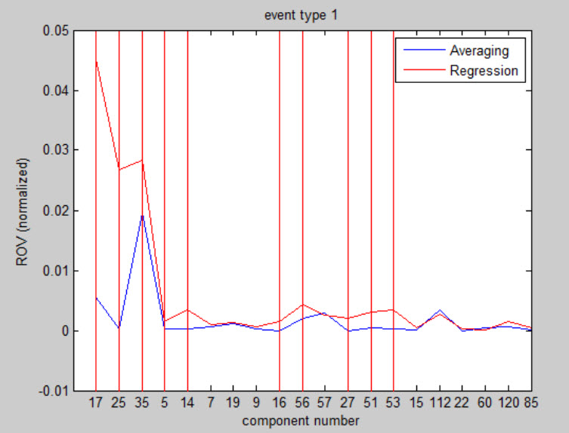
ICA, Event type 1 – ROV (normalized)

Slide 21
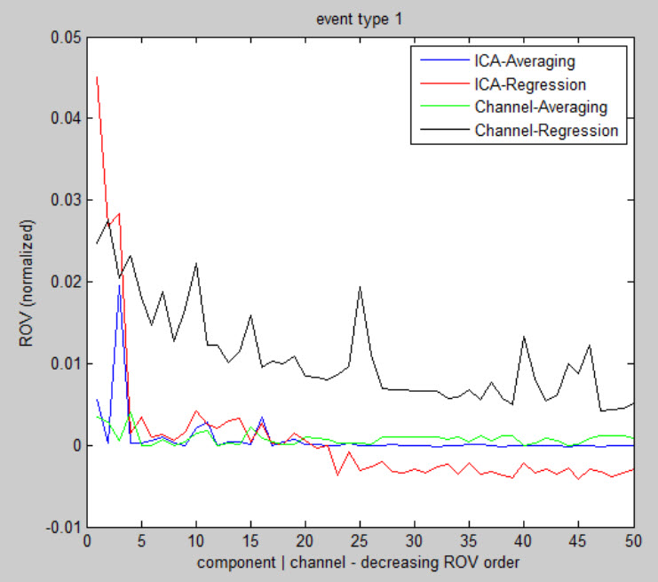
ICA and Channels, type 1 – ROV (Normalized)

Slide 22
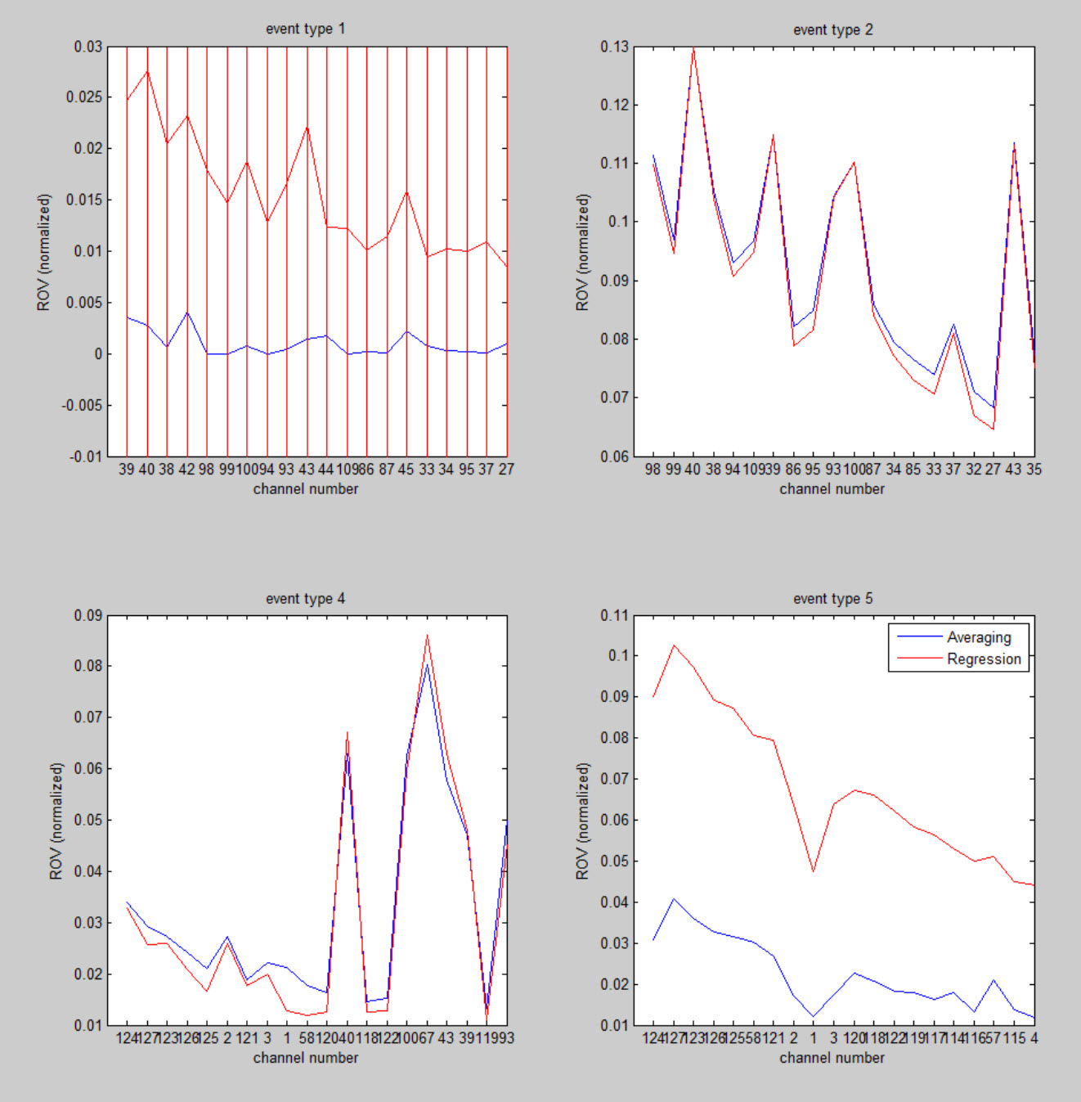
Channels – ROV (normalized)

Slide 23
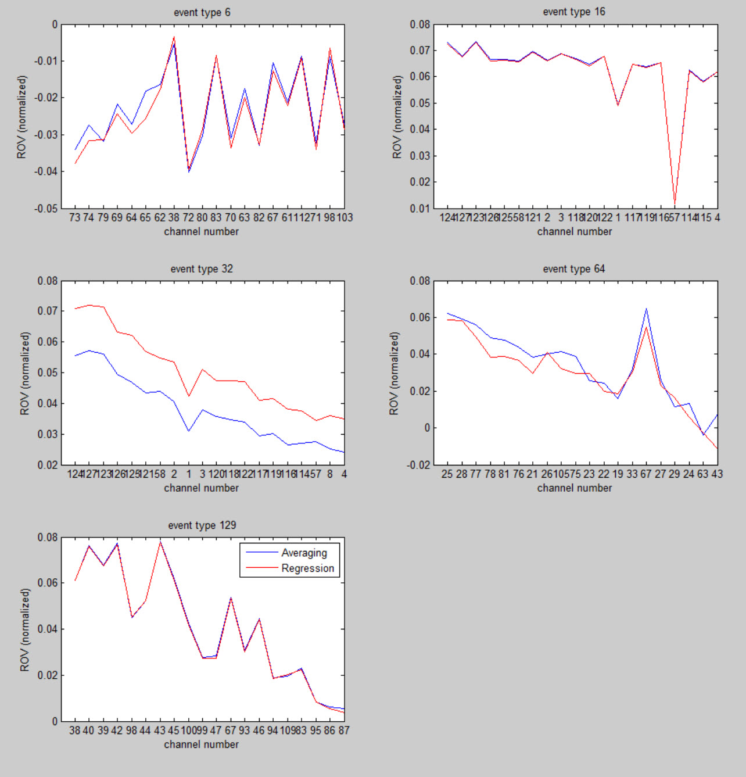
Channels – ROV (normalized)

Slide 24
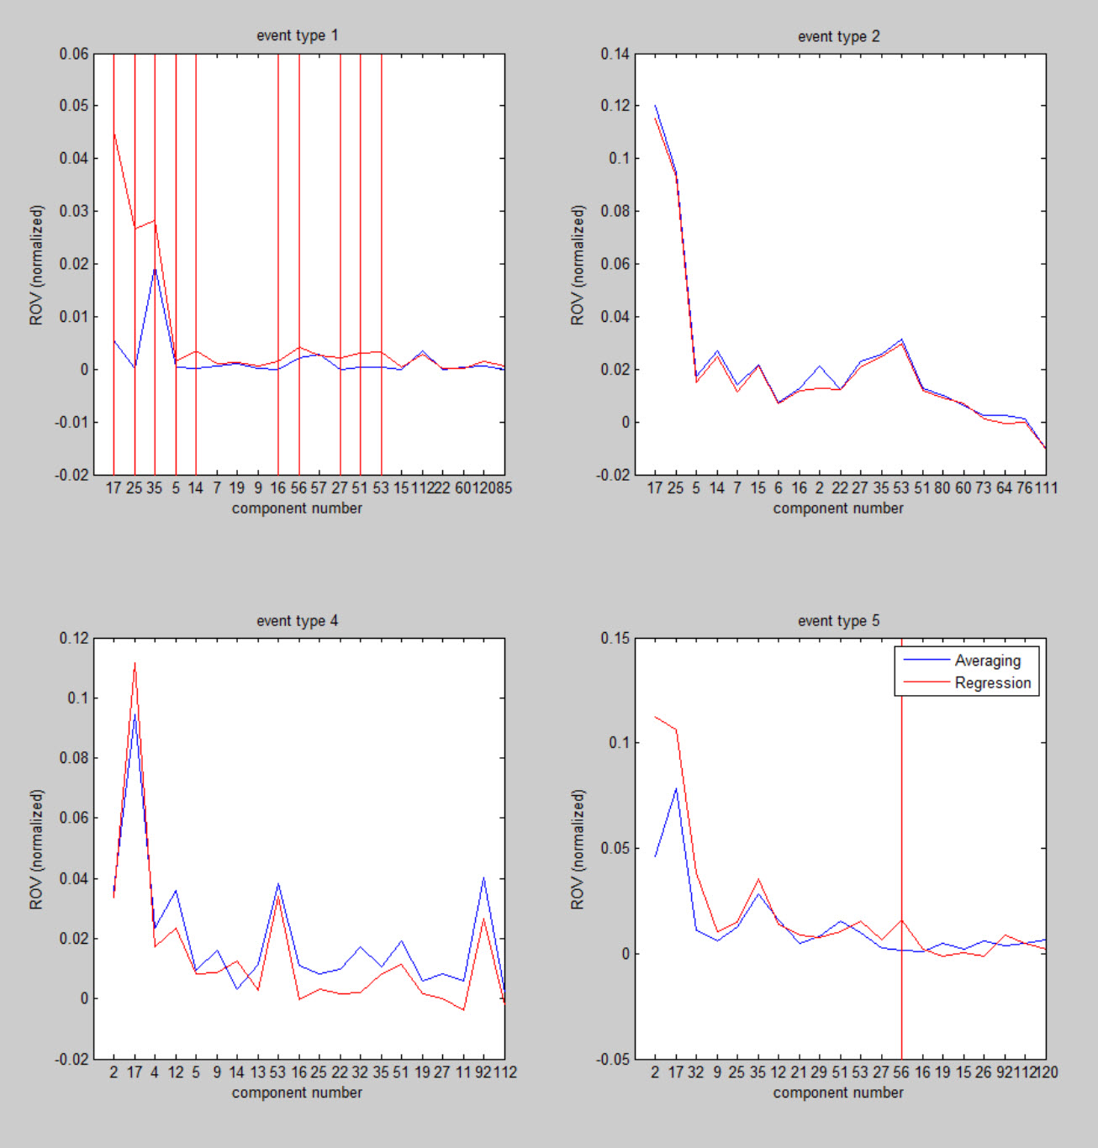
ICA – ROV (normalized)

Slide 25
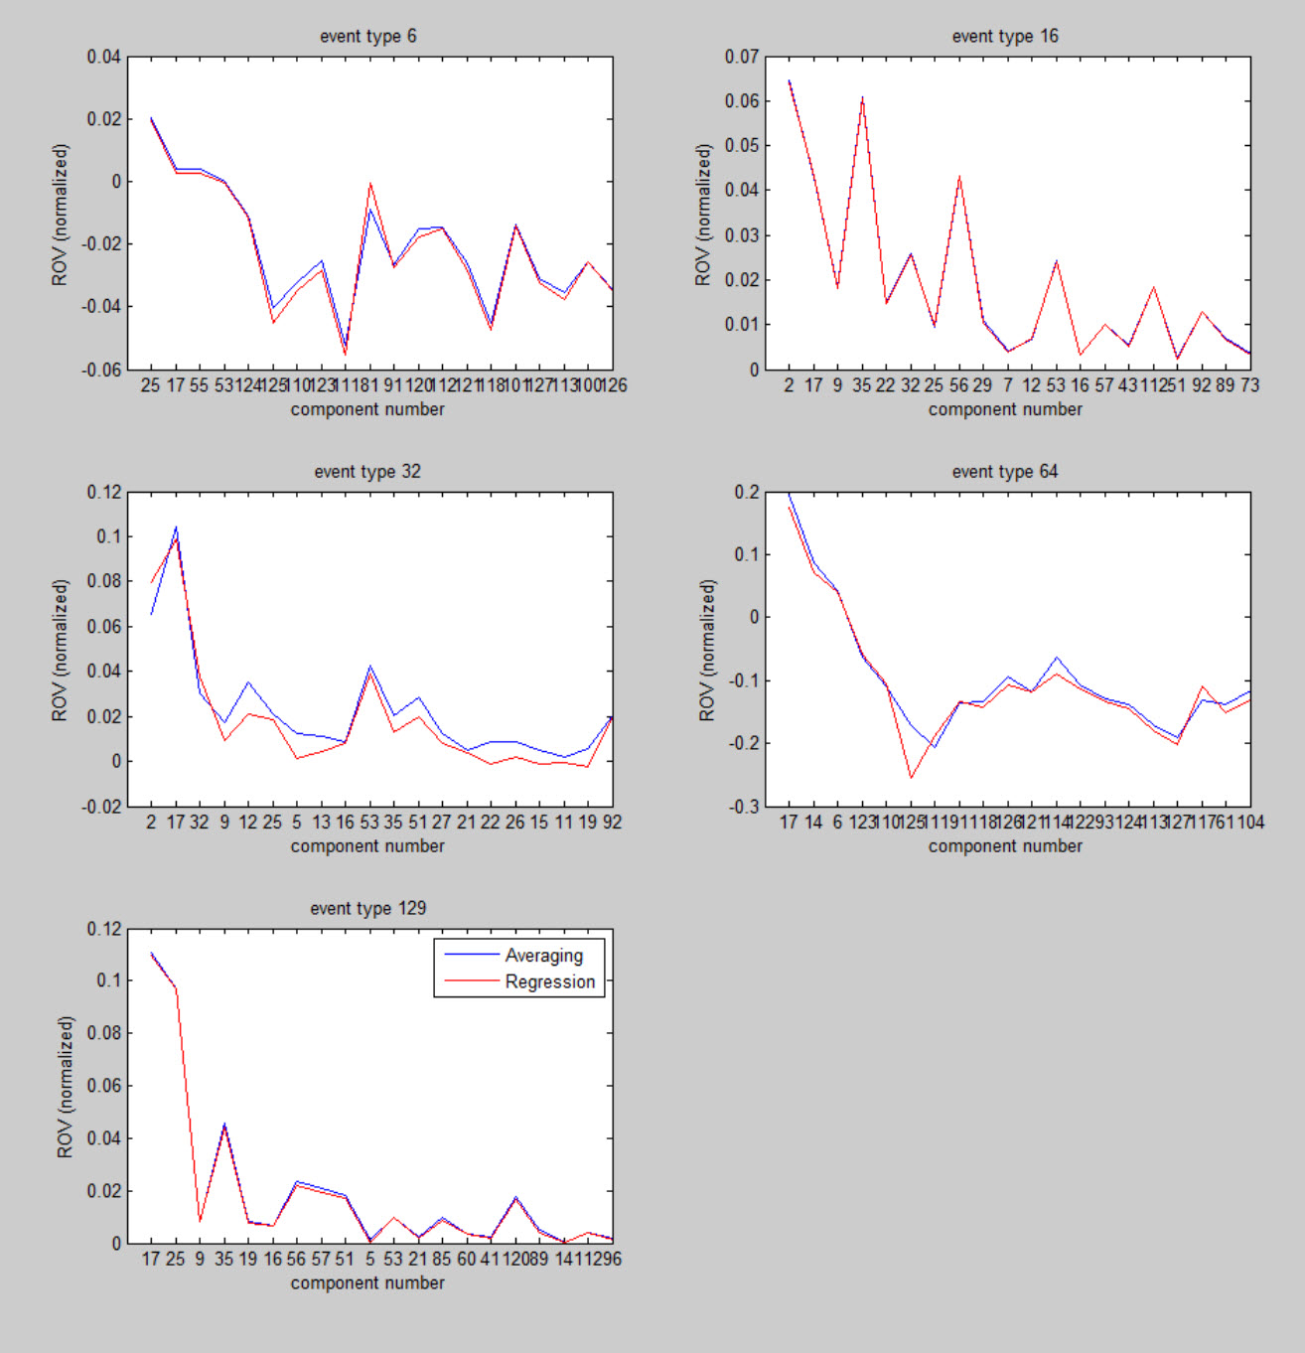
ICA – ROV (normalized)

Slide 26
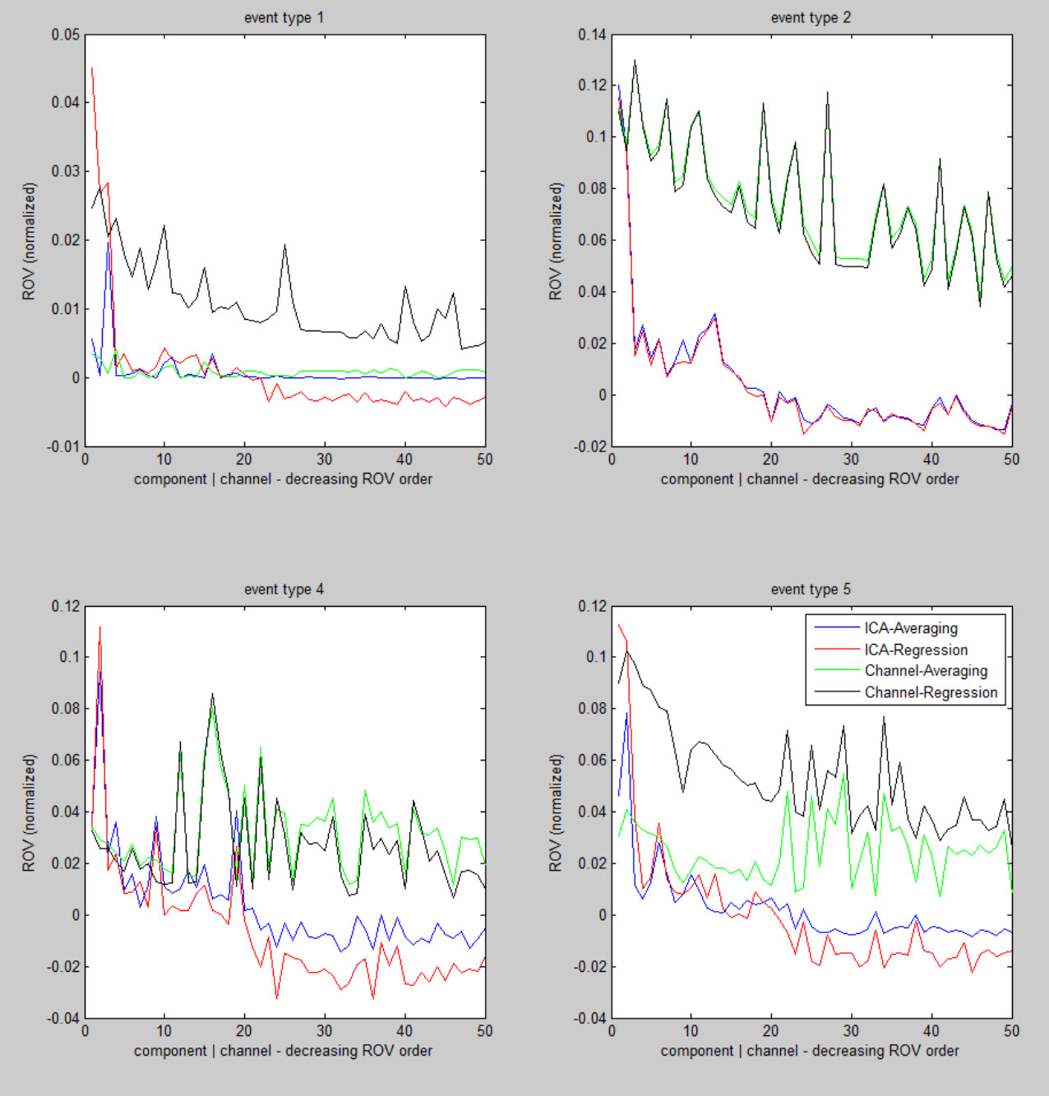
Channels and ICA – ROV (normalized)

Slide 27
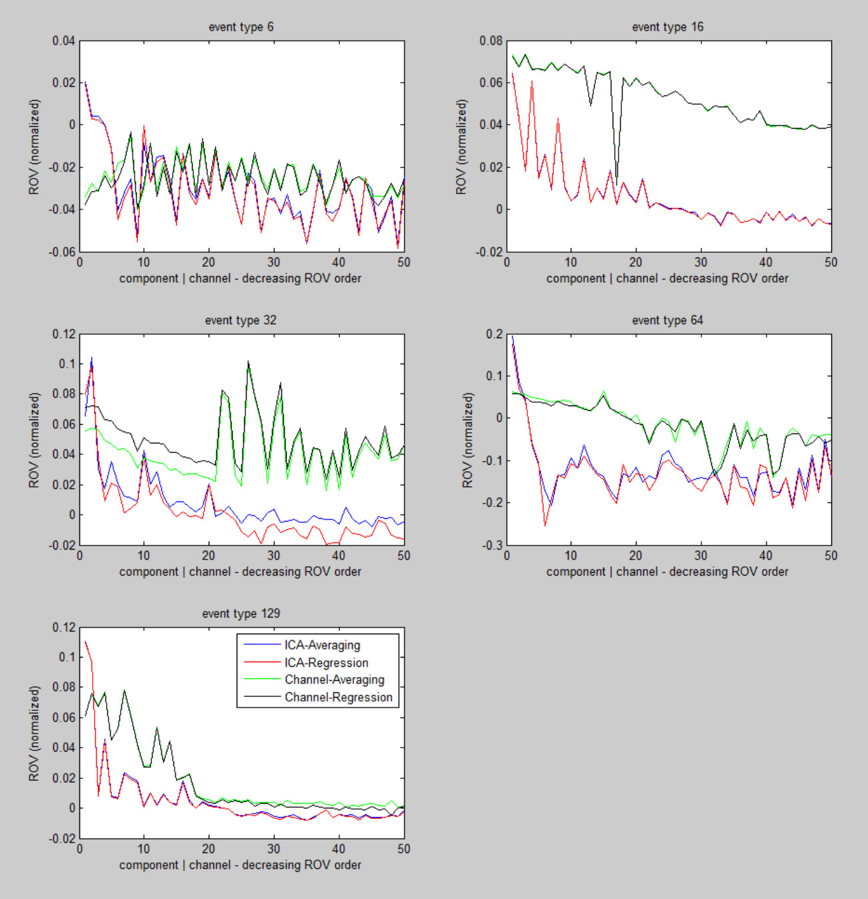
Channels and ICA – ROV (normalized)

Slide 28
Conclusion
Regression better than averaging?
If there is regular overlap with other ERPs, yes.
If there is no overlap, regression produces the same results as averaging.
ICA components show a higher concentration of ROV compared with channels for each method.

Slide 29
Previous Work
Smith, Nathaniel . Scaling Up Psycholinguistics. Dissertation, University of California, San Diego. 2011.
Bigdely-Shamlo, Nima , et al. Brain activity-based image classification from rapid serial visual presentation. IEEE Transactions on Neural Systems and Rehabilitation Engineering. vol. 16, no. 5, pp. 432-441. 2008.

Slide 30
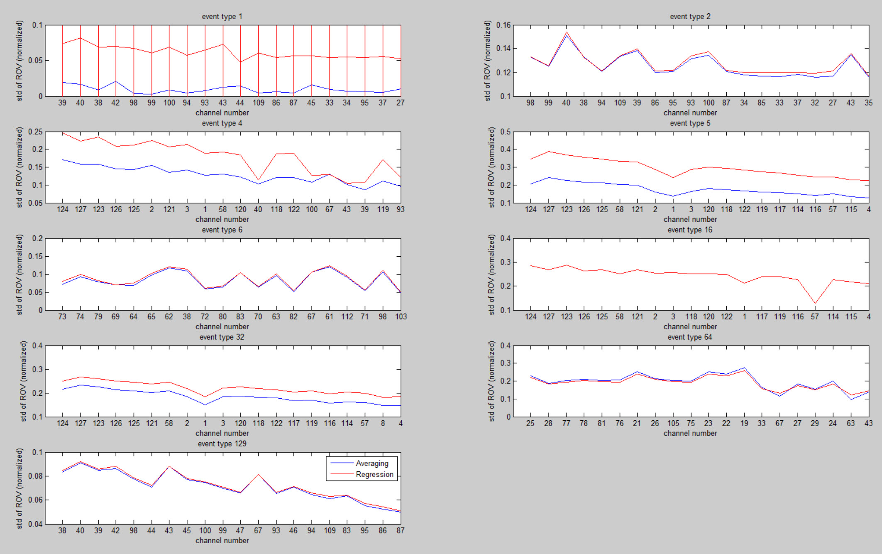
Channels – std dev of ROV (normalized)

Slide 31
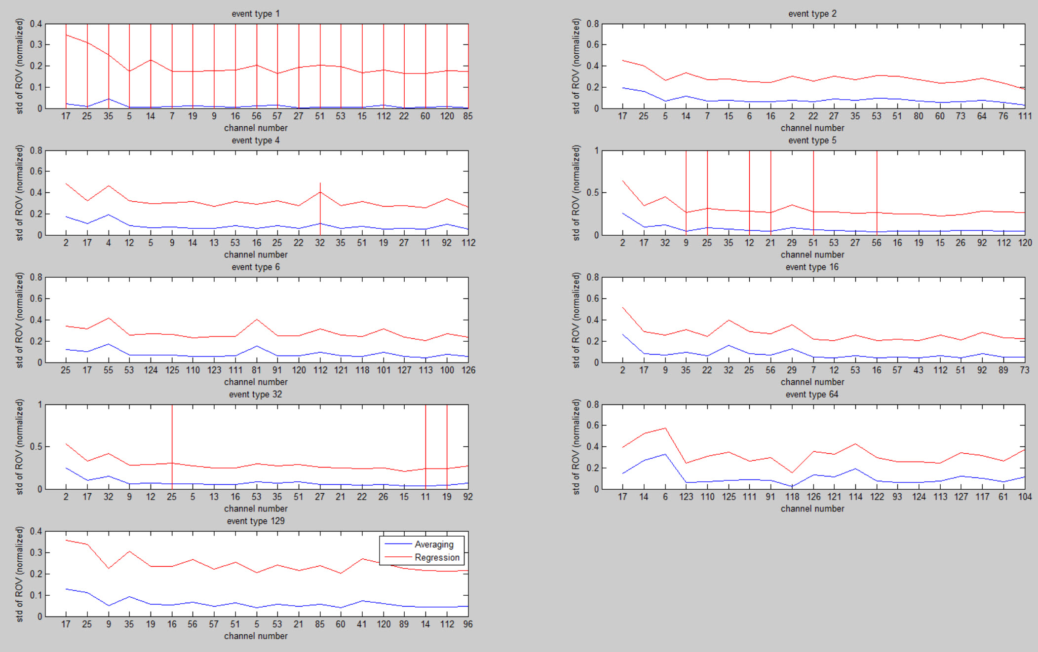
ICA – std dev of ROV (normalized)

Slide 32
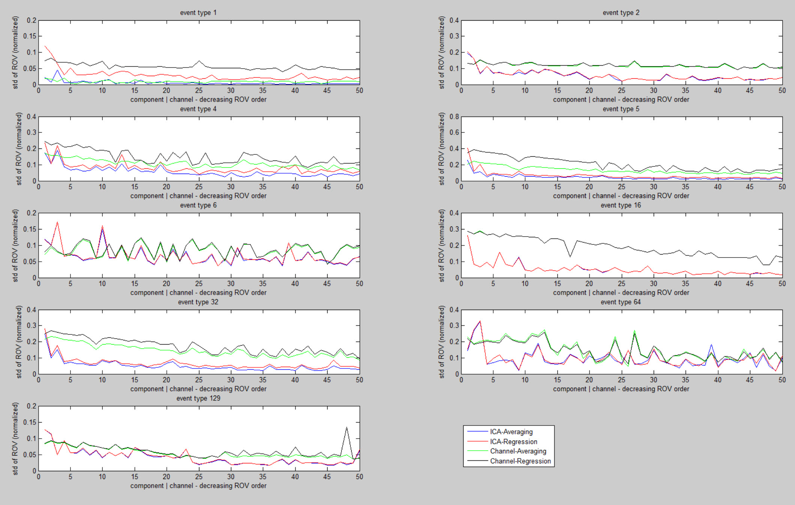
ICA and Channel – std dev of ROV (normalized)

Slide 33
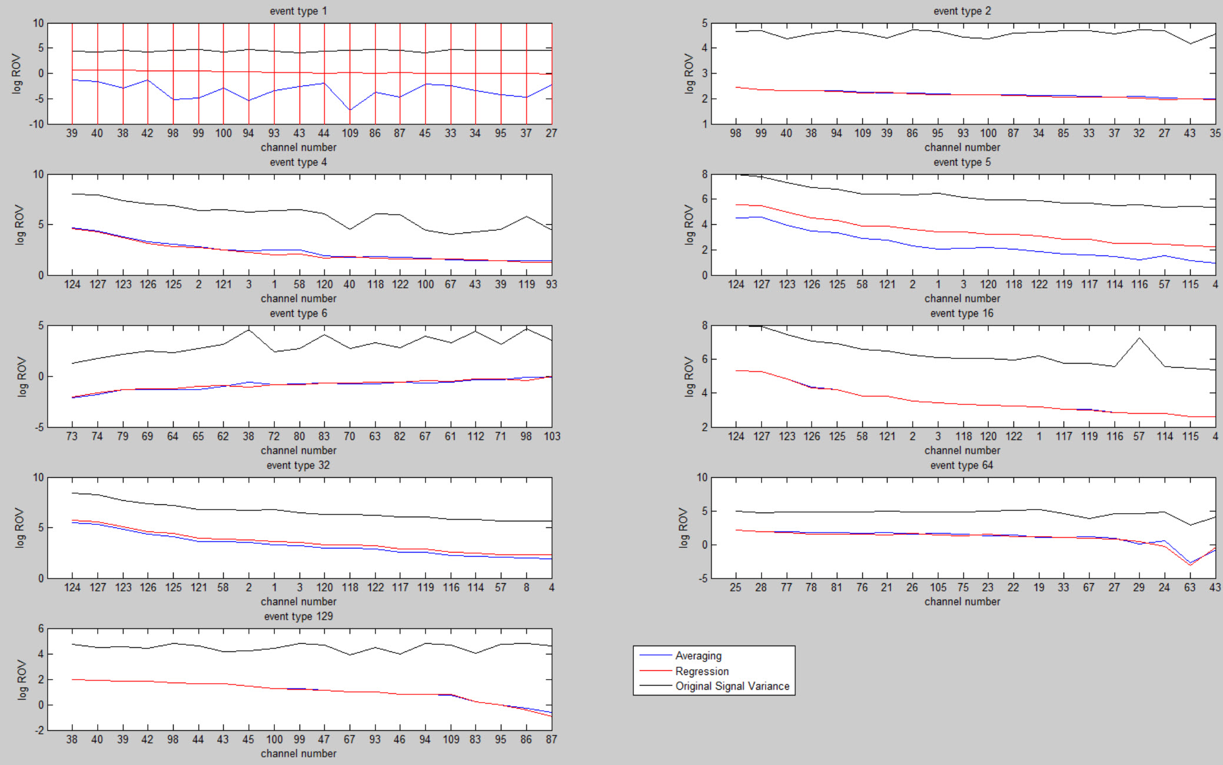
Log(ROV) - Channels

Slide 34
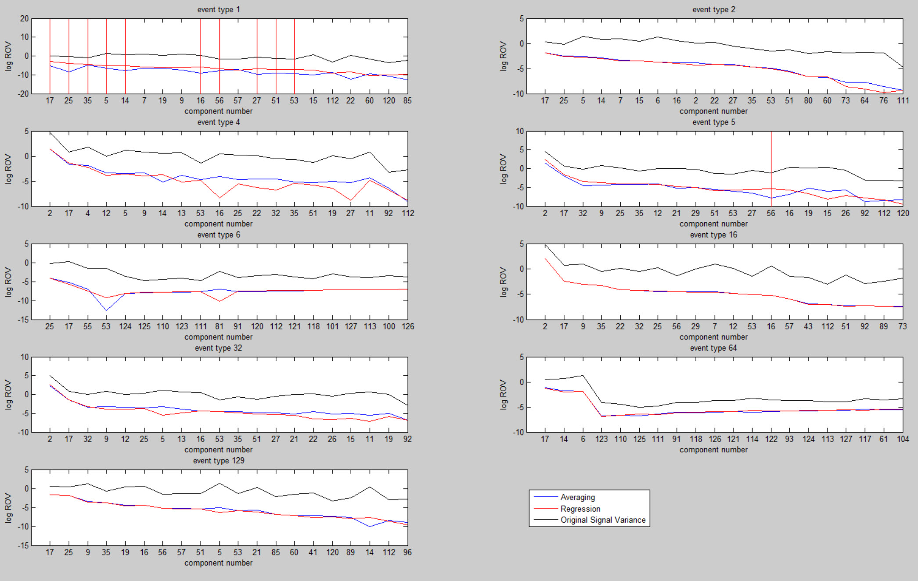
Log(ROV) - ICA

